Slide 1
Websites that I use

Slide 2
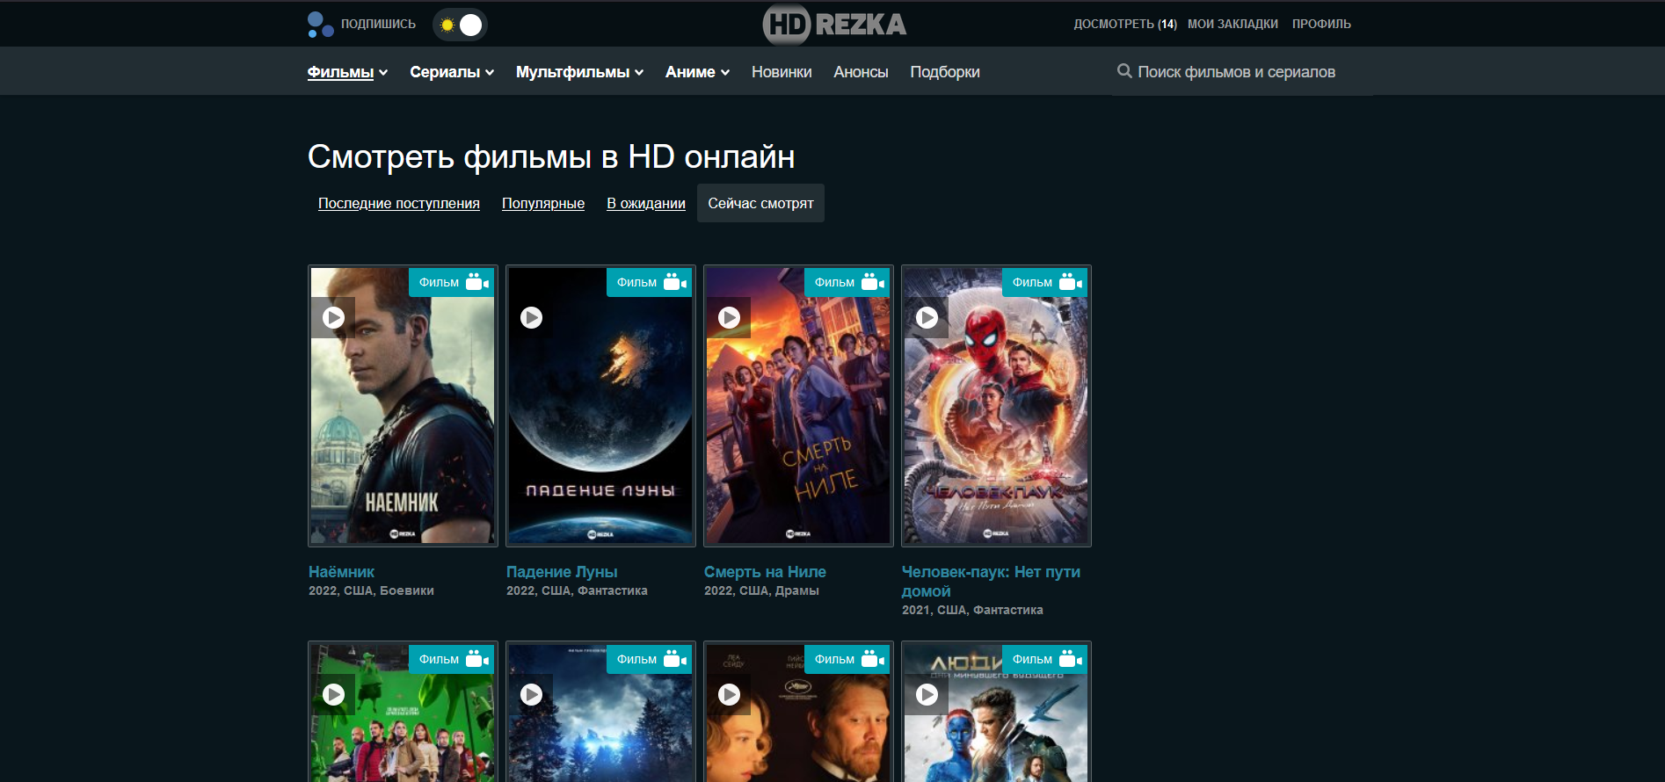
hdrezka.com

Slide 3
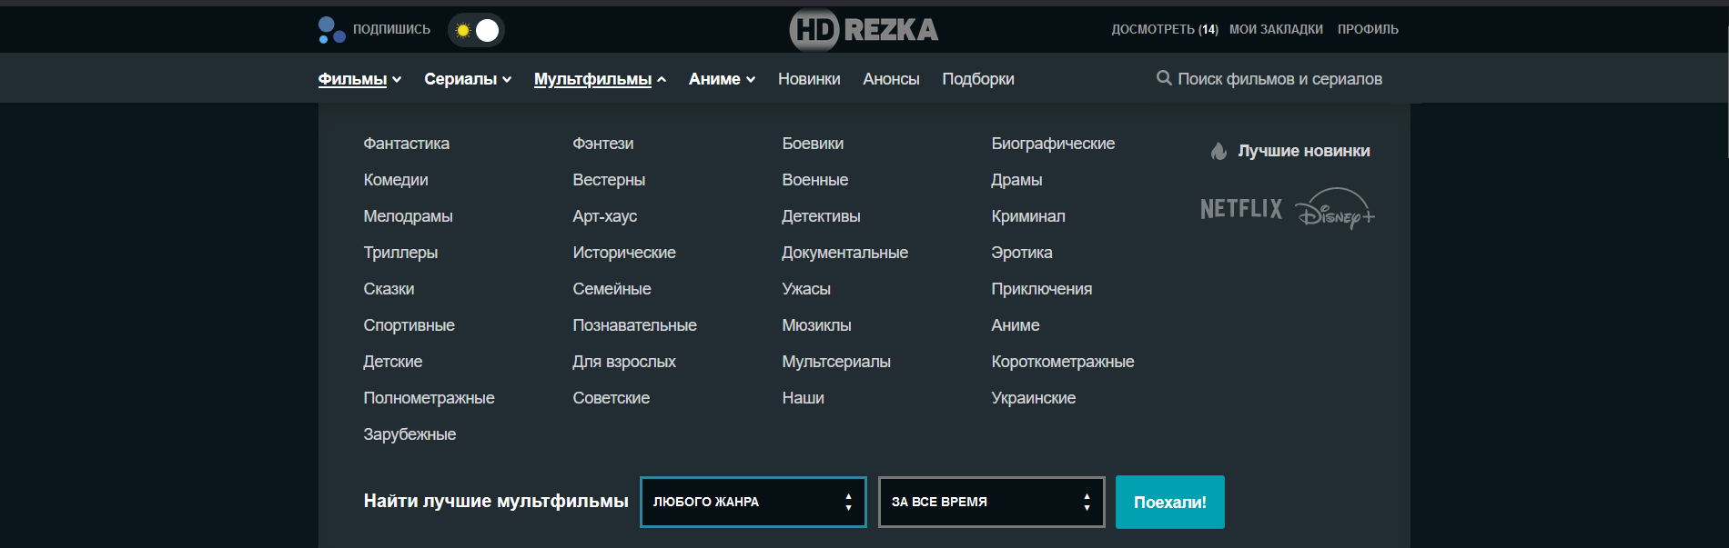
hdrezka.com

Slide 4
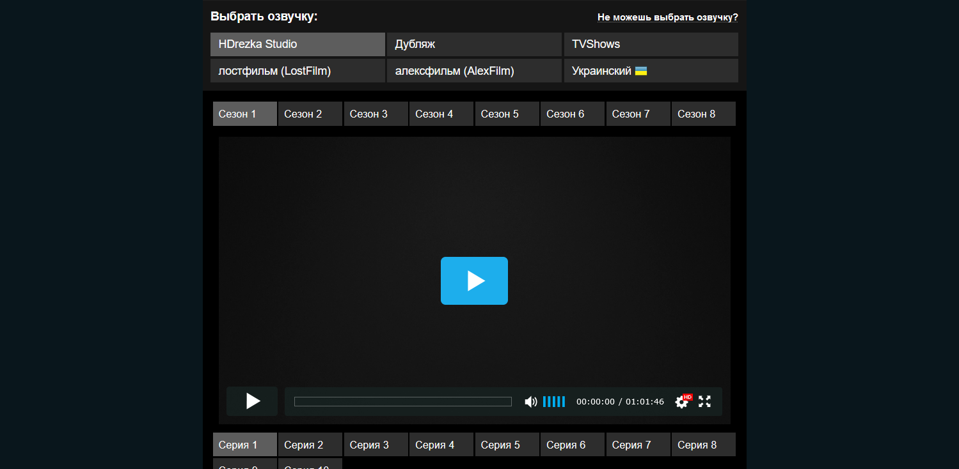
hdrezka.com

Slide 5
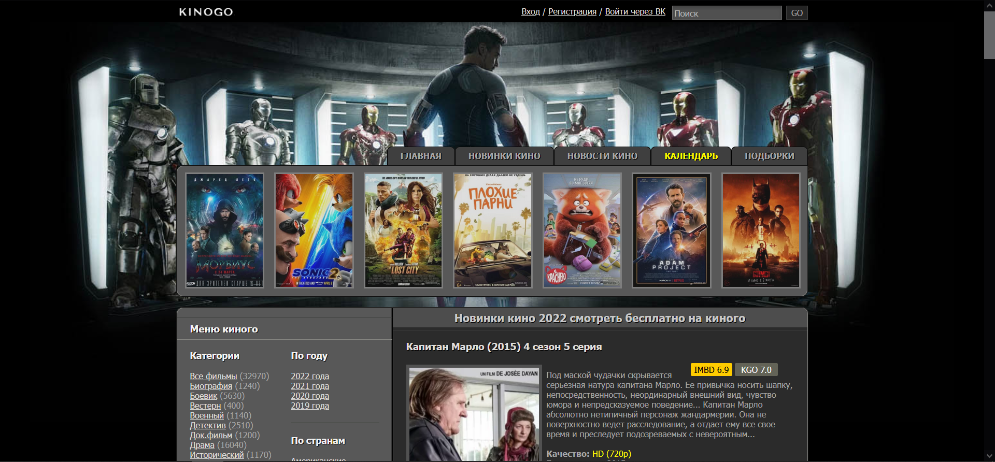
kinogo.cc

Slide 6
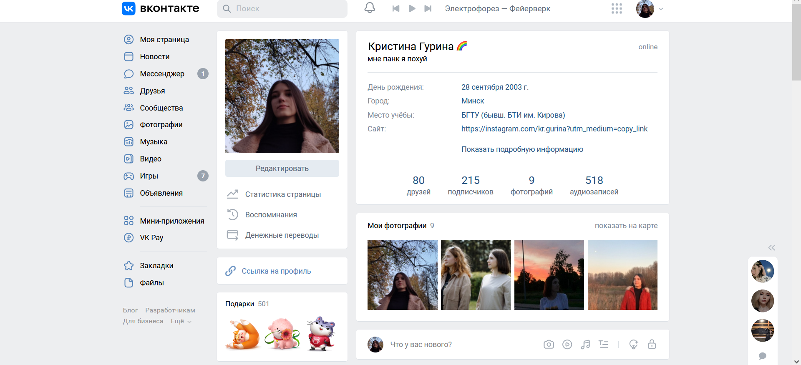
vk.com

Slide 7
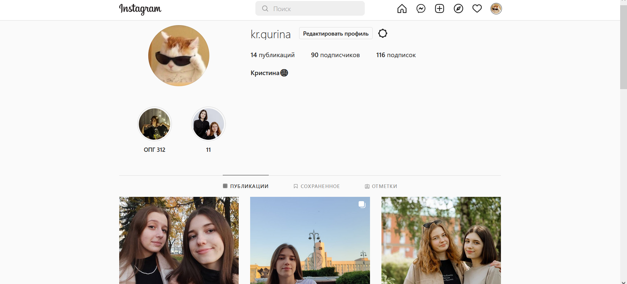
instagram.com

